Slide 1
.NET Development
Dependency Injection (DI)

Slide 2
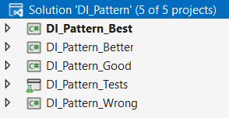
Problem
Open DI_Pattern.sln
When an order is shipped, we want to contact the customer by email
Order class
EmailSender class
public string ContactCustomer(...) { }
public string Contact(...) { }

Slide 3
Exercise
Run the DI_Pattern_Wrong project
Make sure the message “Your shipment …” is sent to customer 1 by email appears in the console.
static void Main(string[] args)
{
Order order = new Order();
order.ContactCustomer(1, "Your shipment will be delivered tomorrow at 4pm.");
Console.ReadKey();
}

Slide 4
Solution 1 - wrong
Hard dependency (tightly coupled)
Order class
uses functionality of
EmailSender class
depends on
EmailSender emailSender = new EmailSender();
emailSender.Contact(...);
public string Contact(...) { }

Slide 5
It works, so it’s Fine?
Order class has a dependency of the EmailSender class
because it creates an object of the EmailSender class
A dependency is an object that another object depends on
EmailSender class has functionality (Contact method) that the Order class uses
What if we decide to contact the customer by phone instead of by email?
Use the TelSender class.
Make the appropriate changes in the solution!
EmailSender emailSender = new EmailSender();

Slide 6
What did we do?
We changed our code by
Removing object creation of EmailSender class
Adding object creation of TelSender class
In case our application was already deployed, we had to recompile and redeploy it because of these code changes.

Slide 7
Is our code testable?
Open the UnitTest_DI_Pattern_Wrong.cs class inside the DI_Pattern_Tests project.
We want to test the HandleOrder functionality from the OrderHandler class.
But the HandleOrder() method executes the ContactCustomer() method
What if this method really contacts the customer (e-mail, tel, ...)?
Is it possible to mock the TelSender class and change its behavior to help us creating good unit tests?
NO!!!

Slide 8
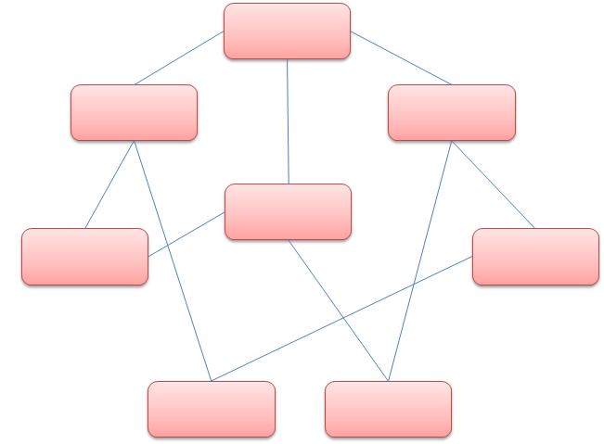
Conclusion
In Object Oriented Programming objects work together in a collaboration model where there are contributors and consumers. Naturally, this communication model generates dependencies between objects and components, resulting in an extremely difficult scenario to manage and to test when complexity increases.

Slide 9
Solution 2 - good
Let’s think of a better solution.
Can we move the creation of the dependent objects (EmailSender/TelSender) outside of the class that depends on it (Order) and still be able to use these objects ?
= Inversion of control (IOC)
= Dependency Injection (DI)
Open project DI_Pattern_Good and follow the next steps.
Notes:
IOC is as design principle providing some high-level guidelines to remove the tight-coupled dependencies between classes in order to make the application more decoupled, maintainable and testable.
DI is the corresponding design pattern that implements IOC and instructs us in detail how to develop loosely coupled code. Using the Dependency Injection design pattern, we can move the dependent objects creation and binding outside of the class that depends on it and provide this object differently to the dependent class.

Slide 10
IOC & DI
IOC is as design principle providing some high-level guidelines to remove the tight-coupled dependencies between classes in order to make the application more decoupled, maintainable and testable.
DI is the corresponding design pattern that implements IOC and instructs us in detail how to develop loosely coupled code. Using the Dependency Injection design pattern means that objects do not create other objects on which they rely to do their work. Instead, they get the objects that they need from an outside source.

Slide 11
Step 1 – IContact interface
Create an interface IContact with a Contact method.
Make sure that the EmailSender class implements this interface.
Make sure that the TelSender class implements this interface.
public interface IContact
{
string Contact(int customerId, string message);
}

Slide 12
Step 2 – Order class
We no longer create an object of the EmailSender or TelSender class.
We now use the IContact interface in the constructor to ‘inject’ a class which implements this interface
The order class doesn’t need to know exactly which class comes in
... but it knows that this class must implement a Contact method
= Constructor injection

Slide 13
Step 2 – Order class
public class Order
{
IContact medium;
public Order(IContact medium)
{
this.medium = medium;
}
public string ContactCustomer(int customerId, string message)
{
return medium.Contact(customerId, message);
}
}
The incoming medium can either be an instance of EmailSender or TelSender

Slide 14
Step 3 – pass the dependency
Go to program.cs
Create an instance of the Order class
Pass a new instance of the EmailSender class as parameter (constructor argument)
Order order = new Order(new EmailSender());
order.ContactCustomer(1, "Your shipment will be delivered tomorrow at 4pm.");
Change the parameter to a new instance of the TelSender class
Order order = new Order(new TelSender());
order.ContactCustomer(1, "Your shipment will be delivered tomorrow at 4pm.");

Slide 15
Step 4 – unit test
Check the unit test class in the UnitTest_DI_Pattern_Good project.
Uncomment the Test_OrderHandler_HandleOrder test.
Because the dependency is now injected via the IContact interface, we can mock it and change its behavior.
In the unit test we can simulate the execution of the Contact method so
The actual code is NOT executed
We can simply return the result that we want: the return message of the Contact method
Notes:
Mocks are meant as test doubles.
The concept of mocking is to simulate the input parameters and the results returned by your method.

Slide 16

Mocking
A quick guide to mocking via Moq library.
Install latest version Moq via NuGet Package Manager
Import Moq library
using Moq;
Create a Mock object based on the interface
public void Test_Order_ContactCustomer()
{
var mediumSender = new Mock<IContact>();
Notes:
https://riptutorial.com/moq
Moq is a mocking library for .Net. It allows interactions with dependencies to be simulated and verified in order to facilitate unit testing.

Slide 17
Mocking
Then we change the behavior of the Contact method
When the Contact method is called (the values of the parameters don’t matter, it can be any int and any string) ...
... a string is returned
Finally, we pass the Object of the mock to the constructor of the Order class
mediumSender.Setup(e => e.Contact(It.IsAny<int>(), It.IsAny<string>()))
.Returns("A test message for this wonderful test");
Order order = new Order(mediumSender.Object)

Slide 18
Mocking
Allows us to test the HandleOrder method in the OrderHandler class with test data that never changes, and it doesn’t matter which class (= dependency) is really used in the application
Allows us to simulate methods so they are not really executed but a value that we choose is returned (which might be used further in the tested method)

Slide 19
Solution 3 - better
Open project DI_Pattern_Better
In solution 2 we used an interface to abstract the dependency implementation.
Next step is the registration of this dependencies in the built-in service container IServiceProvider.
First the link between the interface and its implementation is added to a ServiceCollection.
Once all services are added to the collection, use BuildServiceProvider to create the service container.
Finally, in your program use IServiceProvider’s GetRequiredService () method to obtain the object that provides the service.

Slide 20
RegisterServices() at start-up
using Microsoft.Extensions.DependencyInjection;
private static IServiceProvider _serviceProvider;
static void Main(string[] args)
{
RegisterServices();
Order order = new Order(_serviceProvider.GetRequiredService<IContact>());
…
}
private static void RegisterServices()
{
var services = new ServiceCollection();
//register interfaces using factory that returns implementation
services.AddSingleton<IContact, EmailSender>();
_serviceProvider = services.BuildServiceProvider(true);
}

Slide 21
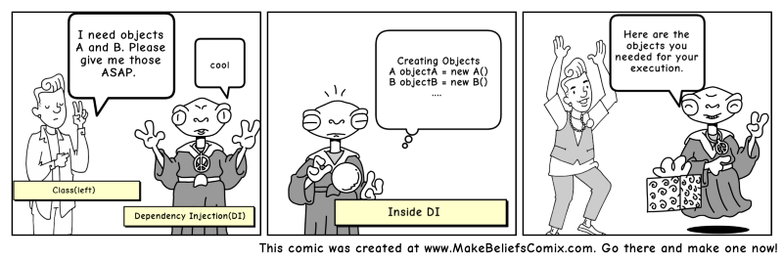
RegisterServices()
Instantiate a ServiceCollection
Add pairs of interfaces and implementations as singletons to the ServiceCollection
Build the ServiceProvider.

Slide 22
RegisterServices()
Services can be added to the ServiceCollection in 3 ways
Transient objects are always different; each call a new instance is provided
Scoped objects remain the same within a request, but different across different requests. Think of ApplicationDBContext in ASP.NET MVC.
Singleton objects are the same for every object and every request.
services.AddTransient<IOperationTransient, Operation>();
services.AddScoped<IOperationScoped, Operation>();
services.AddSingleton<IOperationSingleton, Operation>();

Slide 23
Multiple implementations of the same interface
What if we want to implement the TelSender class?
Register TelSender as an implementation of IContact
Now, we have different implementations of the same interface
private static void RegisterServices()
{
var services = new ServiceCollection();
services.AddSingleton<IContact, EmailSender>();
services.AddSingleton<IContact, TelSender>();
_serviceProvider = services.BuildServiceProvider(true);
}

Slide 24
Multiple implementations of the same interface
_serviceProvider.GetRequiredService<IContact> will always return the last registered service → Last In First Out → TelSender
ServiceProvider GetServices<type> () returns an enumerable of all available services
static void Main(string[] args)
{
RegisterServices();
Order order = new Order(_serviceProvider.GetServices<IContact>().ElementAt(0));
order.ContactCustomer(1, "Finally shipped tomorrow at 4PM");
Console.ReadKey();
}
MailSender

Slide 25
Unit test
Check the Test_OrderHandler_HandleOrder unit test class in the UnitTest_DI_Pattern_Better project.
It is the same test!
Uncomment the Test_OrderHandler_HandleOrder test.
Test it out!

Slide 26
Solution 4 - best
We still have to change code if we want to use the TelSender class instead of the EmailSender class or vice versa.
We can fix this by creating a configuration file in XML or JSON, where we describe which interface is implemented by which class.
This way we can link the EmailSender or the TelSender class to the IContact interface. If we want to switch, we just have to alter the configuration file.
In code the link between the interface and the needed implementation is still registered as a service in the project’s ServiceCollection.

Slide 27
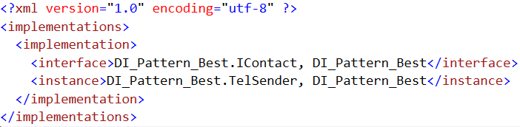
Config
XML file → di_configuration.xml

Slide 28
RegisterServices() in program.cs
private static void RegisterServices()
{
var services = new ServiceCollection();
//We get the correct instances from the xml file
XmlReaderSettings settings = new XmlReaderSettings();
settings.IgnoreWhitespace = true;
// Load the document and set the root element.
XmlDocument doc = new XmlDocument();
doc.Load("config\\di_configuration.xml");
XmlNode root = doc.DocumentElement;
XmlNodeList nodeList = root.SelectNodes("implementation");
foreach (XmlNode service in nodeList)
{
//firstchild = interface
//lastchild = instance
services.AddSingleton(Type.GetType(service.FirstChild.InnerText), Type.GetType(service.LastChild.InnerText));
}
_serviceProvider = services.BuildServiceProvider(true);
}
Code for reading XML file

Slide 29
Main()
static void Main(string[] args)
{
RegisterServices();
//We get the correct instance from the RegisterServices method
Order order = new Order(_serviceProvider.GetRequiredService<IContact>());
order.ContactCustomer(1, "Your shipment will be delivered tomorrow at 4pm.");
Console.ReadKey();
DisposeServices();
}
Notes:
Dispose is not necessary.
The container is responsible for cleanup of types it creates, and calls Dispose on IDisposable instances. Services resolved from the container should never be disposed by the developer. If a type or factory is registered as a singleton, the container disposes the singleton automatically.

